Slide 1

FIFA WORLD CUP ANALYSIS
YASHRAJ RAI

Slide 2

PROJECT DETAILS
Technology - Business Intelligence
Domain - Sports
Difficulty - Advance Language –
Exploratory Data Analysis using Python
Solution – GitHub Link and POWER BI Public Link
This Photo by Unknown Author is licensed under CC BY-SA

Slide 3
PROBLEM STATEMENT
With FIFA being in the blood as many people of the world. You are tasked to tell the story of unsung analysts who put great efforts to provide accurate data to answer every question of fans.
The FIFA World Cup is a global football competition contested by the various football-playing nations of the world. It is contested every four years and is the most prestigious and important trophy in the sport of football.
The World Cups dataset show all information about all the World Cups in the history, while the World Cup Matches dataset shows all the results from the matches contested as part of the cups.
Find key metrics and factors that influence the World Cup win.

Slide 4

OBJECTIVE
To gain insightful knowledge from the FIFA WORLD CUP dataset and to visually present some fascinating figures for football enthusiasts
This research is centered on an analysis of the FIFA World Cup to learn more about the matches, player patterns, cupholder trends, home field advantage, and many other factors.
This Photo by Unknown Author is licensed under CC BY-SA-NC

Slide 5
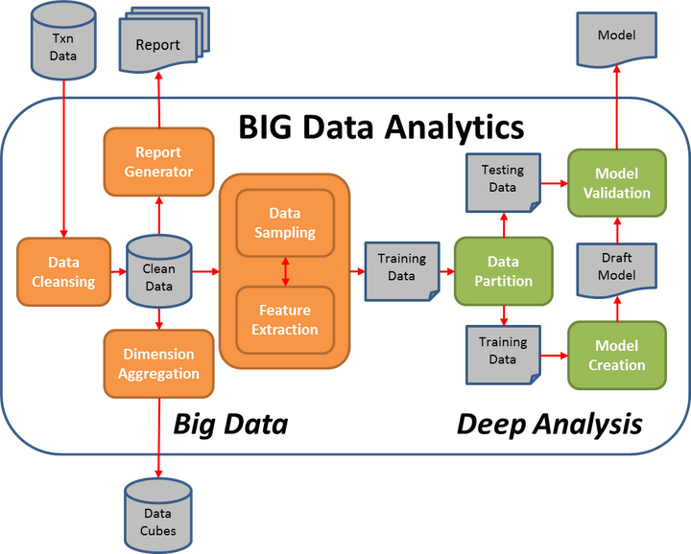
ARCHITECTURE
This Photo by Unknown Author is licensed under CC BY-SA

Slide 6
OUTCOMES
Most World Cup championships won
Number of Goal Per Country
Attendance, Number of Teams, Goals, and Matches per World Cup
Goals Per Team Per World Cup
Matches With Highest Number Of Attendance
Stadium with Highest Average Attendance
Which countries had won the cup ?
Which countries had won the cup most no of times ?
Number of goal per country
Match outcome by home and away teams

Slide 7
VISUALIZATION PROCESS 1
Collecting Data
The collecting of enormous volumes of data is the first and most crucial stage in data visualization. Data visualization techniques can only be applied to the data acquired in order to gain some useful insights.
Clean Your Data
Data cleaning is an essential step to perform before creating a visualization. A bunch of data out of a large dataset that has in appropriate, empty, or false values may lead to add in visuals with anomalies in it.
The output received from a data cleaning process is usually a dataset that is free of errors and anomalies etc. which gives much more accuracy when data is processed. Data cleaning is pretty much dependent on the dataset domain that you’re working with.

Slide 8
VISUALIZATION PROCESS 2
Prepare Data
To prepare the data before sending it further for visualization is to determine the type of graph, chart, or any other visualizations you need to create and the supporting library you will be integrating for it. After the chart is finalized it may be necessary to transform the data as per requirements.
Data preparation tasks include finding data columns that help make some decisions out of it, giving some meaningful insights about data, grouping data, creating aggregate values for groups, combining variables to create new columns, etc
Choose a chart type
Understanding your audience before selecting a visual chart or graph can help you select the one that will effectively convey your message.
Choosing a chart totally depends on what findings you need to convey to your audience.
Visualize Data
In the final step, you ’ll have the required data we need to create visualizations. Now we can apply all our visualizations skills on the prepared data and represent the data in charts or graphs with meaningful insights.

Slide 9

Thank you
YASHRAJ RAI
YASHRAJ.RAI18@GMAIL.com |https://github.com/Yash2412000/FIFA-WORLD-CUP-INTERNSHIP

